Slide 1
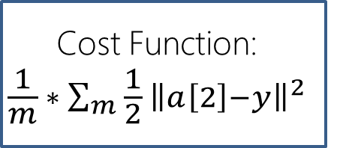
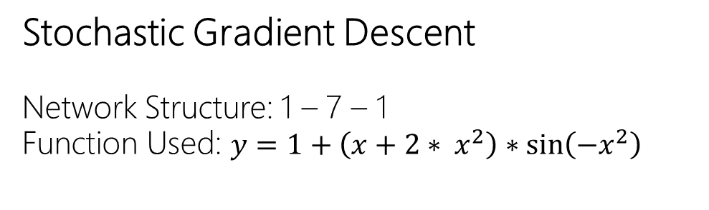
Stochastic Gradient Descent
Network Structure: 1 – 7 – 1
Function Used: $y=1+\left(x+2∗ x^{2}\right)∗\sin\left(−x^{2}\right)$
x
z[1]
a[1]
z[2]
a[2]
Cost Function:
$$\frac{1}{m} ∗ \sum_{m}{\frac{1}{2} {\left\|a\left[2\right]−y\right\|}^{2}}$$
w[1]
b[1]
w[2]
b[2]
Forward Pass
dz[1]
da[1]
dz[2]
da[2]
dw[1]
db[1]
dw[2]
db[2]
Back propagating the errors

Slide 2
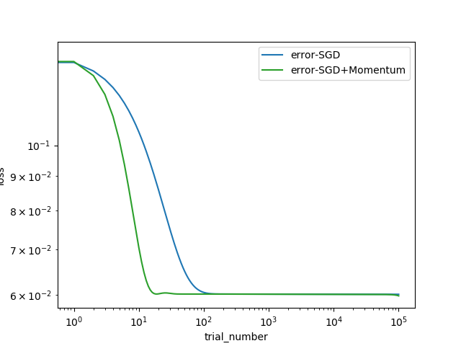
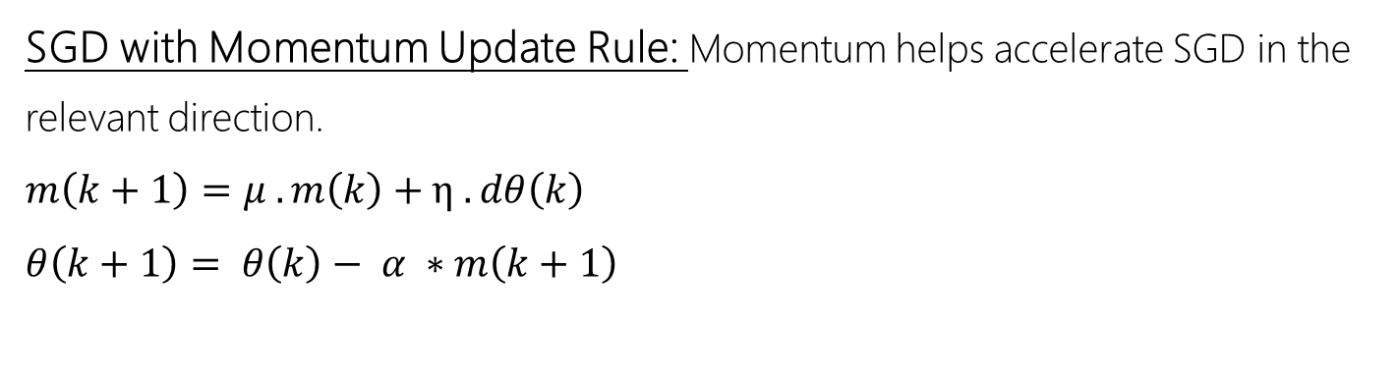
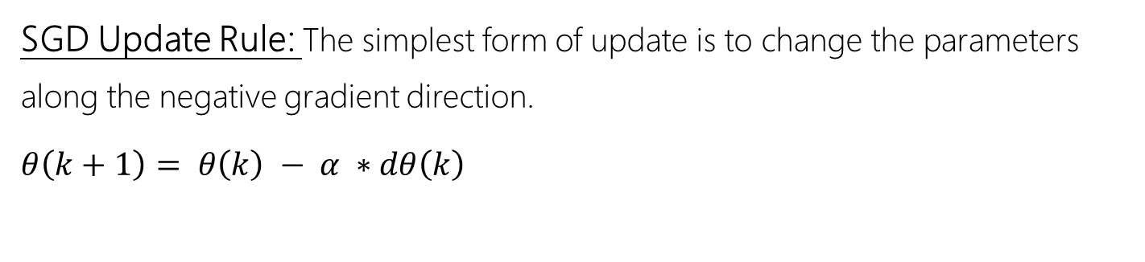
SGD Update Rule: The simplest form of update is to change the parameters along the negative gradient direction.
$θ\left(k+1\right)= θ\left(k\right) − α ∗dθ\left(k\right)$
SGD with Momentum Update Rule: Momentum helps accelerate SGD in the relevant direction.
$m\left(k+1\right)=μ . m\left(k\right)+η . dθ\left(k\right)$
$θ\left(k+1\right)= θ\left(k\right)− α ∗m\left(k+1\right)$

